Slide 1
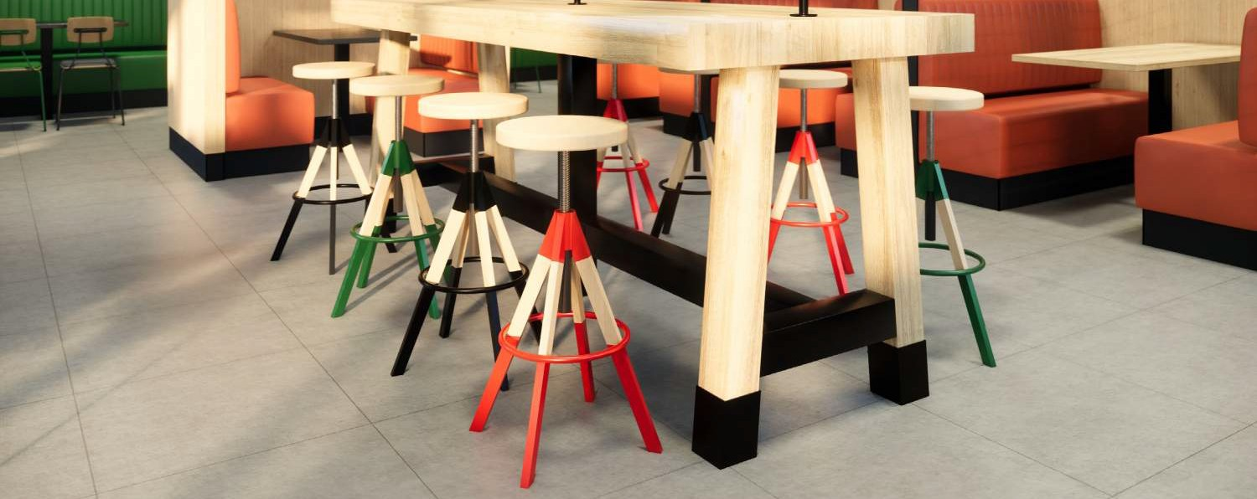
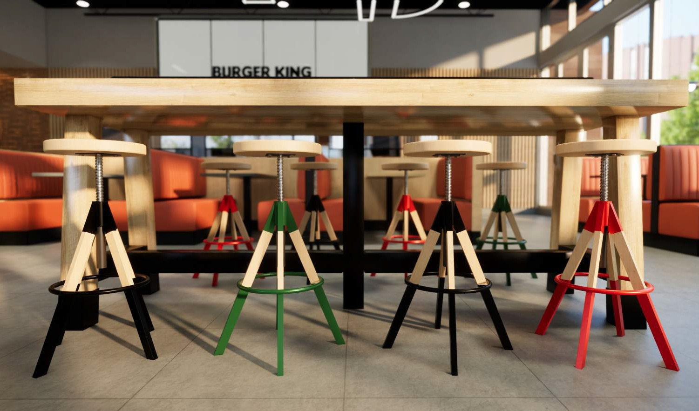
CONTENTS
BAR STOOLS - OPTION 2
Colorful option
Bar stool (Green accent)
Wood seat: WD-7RY Frame finish: MFE-10RY
Bar stool (Red accent)
Wood seat: WD-7RY Frame finish: MFE-11RY
Bar stool (Charcoal accent)
Wood seat: WD-7RY Frame finish: MF-1RY
Tiger Drylac 49/52830 - 38/50031
Tiger Drylac 49/34730
Tiger Drylac 39/60020
Bronze Matte
23

Slide 2
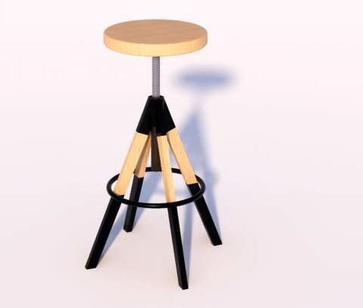
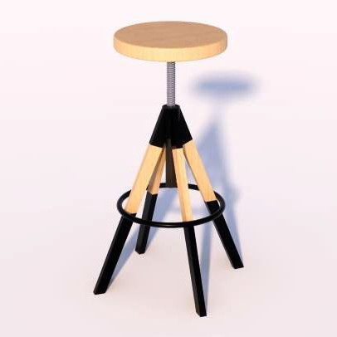
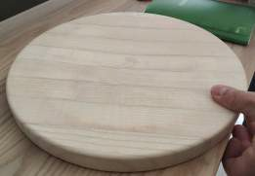
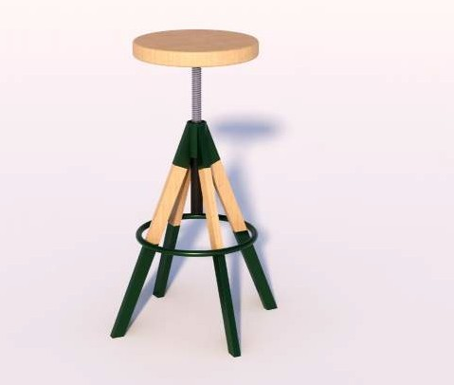
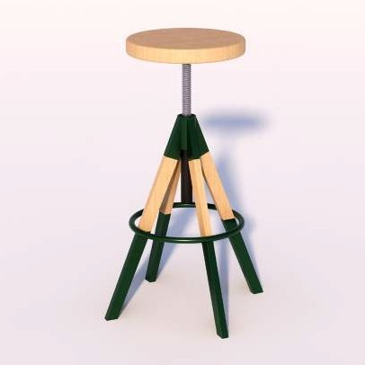
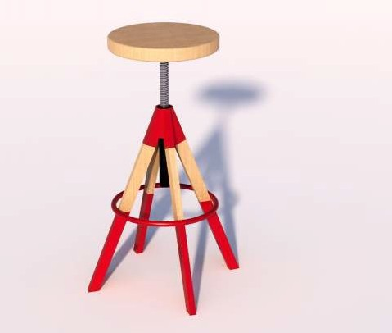
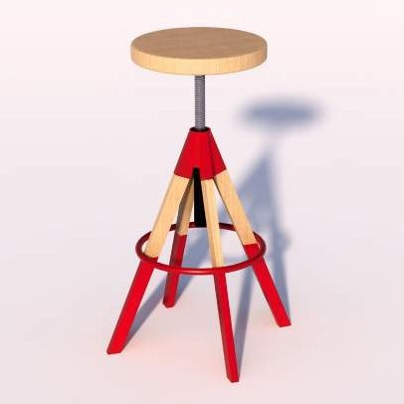
BAR STOOLS - OPTION 2 Colorful option
SPECS
CONTENTS
INDENTATION ON THE SEAT AT 4.5CM OFF SEAT EDGE
CENTRE SUPPORT TO BE POWDERCOATED TO MATCH METAL ACCENTS
Charcoal Option
26MM SEAT THICKNESS STRAIGHT EDGE WITH EASED CORNERS
Top View
SEAT AND FOOTREST SHALL HAVE THE SAME DIAMETER
METAL LEG
OPTION 01:WITH A PORTION CLADDED IN WOOD (SHOWN ON DRAWINGS)
OPTION 02: HEAT TRANSFERRED WOOD FILM INTO METAL LEG
SEAT IS NOT ADJUSTABLE IN HEIGHT
Wood. WD-7RY
Green Option
Fixed metal stick
Powdercoated steel
Wood. WD-7RY
Powdercoated steel
30X40CM (AVERAGE SECTION FOR AN IDEAL STRAIGHT LEG)
Powdercoated steel
Front View
Red Option
CONFIDENTIAL AND PROPRIETARY INFORMATION OF BURGER KING CORPORATION. TM & © 2018 BURGER KING CORPORATION. ALL RIGHTS RESERVED.
Updated
24

