Slide 1
Packaging material Plant Tristone Nová Baňa SVK

Slide 2
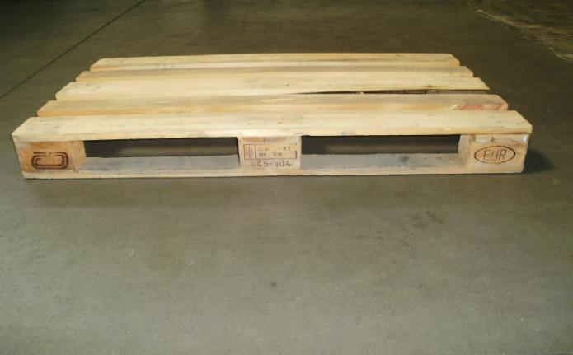
Packaging material – Tristone Nová Baňa SVK
Palette EUR
height 120mm, width 800mm, length 1200mm

Slide 3
Packaging material – Tristone Nová Baňa SVK
One-way palette 1200*800 -SAP: 40PA92S
height 120mm, width 800mm, length 1200mm

Slide 4
Packaging material – Tristone Nová Baňa SVK One-way palette 1200*1000- SAP:40PA51 - height 120mm, width 1000mm, length 1200mm;

Slide 5
Packaging material – Tristone Nová Baňa SVK - cardboard box: length 585mm, width 385mm, height 240mm; material 3VVL, BC.2.30 FEFCO 435 SAP:40CA10A

Slide 6
Packaging material – Tristone Nová Baňa SVK - cardboard box: length 400mm, width 300mm, height 200mm; material 3VVL, B2200BB FEFCO 201 SAP:4CA400300200

Slide 7
Packaging material – Tristone Nová Baňa SVK - cardboard box: length 400mm, width 300mm, height 300mm; material 3VVL, B2200BB FEFCO 201 SAP-40CA12

Slide 8
Packaging material – Tristone Nová Baňa SVK - cardboard layer: length 1080mm, width 910mm, material 3VVL, B2111BB FEFCO 901 SAP- 40IN49

Slide 9
Packaging material – Tristone Nová Baňa SVK - cardboard cover: length 595mm, width 395mm, 65mm height, material 3VVL, B2111BB FEFCO 435 SAP:40CF59539565

Slide 10
Packaging material – Tristone Nová Baňa SVK - cardboard box: length 610mm, width 410mm, height 340mm; material 5VVL, BC580A1 FEFCO 201 SAP:4CA610410340

Slide 11
Packaging material – Tristone Nová Baňa SVK - cardboard layer: length 525mm, width 335mm, material 3VVL, B2111BB FEFCO 901

Slide 12
Packaging material – Tristone Nová Baňa SVK - cardboard layer: length 350mm, width 550mm, material 3VVL, BC25EKRAFT FEFCO 901 SAP:40IN118

Slide 13
Packaging material – Tristone Nová Baňa SVK - cardboard box: length 585mm, width 385mm, height 285mm; material 5VVL, BC580A1 FEFCO 200 SAP:40CA09A

Slide 14
Packaging material – Tristone Nová Baňa SVK - cardboard box: length 585mm, width 385mm, height 242mm; material 5VVL, BC580A1 FEFCO 200 SAP:40CA10

Slide 15
Packaging material – Tristone Nová Baňa SVK - cardboard layer: length 575mm, width 375mm, material 3VVL, BC2111BB FEFCO 901 SAP:40IN54

Slide 16
Packaging material – Tristone Nová Baňa SVK - cardboard layer: length 575mm, width 585mm, material 3VVL, BC1.01B FEFCO 901 SAP:40IN85

Slide 17
Packaging material – Tristone Nová Baňa SVK - cardboard layer: length 780mm, width 380mm, material 3VVL, BC2111BB FEFCO 901

Slide 18
Packaging material – Tristone Nová Baňa SVK - cardboard layer: length 380mm, width 282mm, material 3VVL, BC2111BB FEFCO 901

Slide 19
Packaging material – Tristone Nová Baňa SVK - cardboard box: length 300mm, width 200mm, height 125mm; material 5VVL, BC2.20BC FEFCO 200 SAP:4CA300200125

Slide 20
Packaging material – Tristone Nová Baňa SVK Polyethylen bag - width 720mm, length 780mm

Slide 21
Packaging material – Tristone Nová Baňa SVK Polyethylen bag - width 125mm, length 780mm

Slide 22
Packaging material – Tristone Nová Baňa SVK Polyethylen bag - width 1000mm, length 1000mm

Slide 23
Packaging material – Tristone Nová Baňa SVK Polyethylen bag - width 1000mm, length 780mm

Slide 24
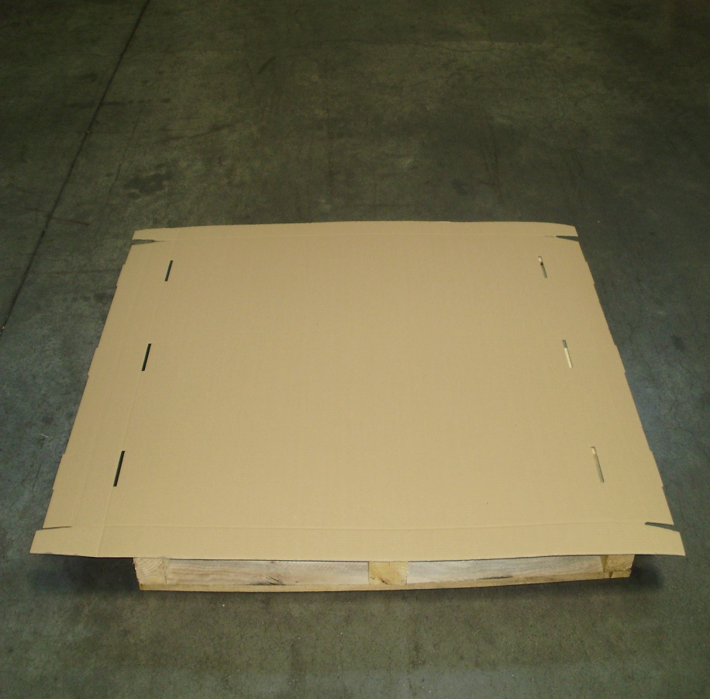
Packaging material – Tristone Nová Baňa SVK - cardboard cover: length 1195mm, width 995mm, 65mm height, material 3VVL, B2111BB FEFCO 435

Slide 25
Packaging material – Tristone Nová Baňa SVK - cardboard cover: length 990mm, width 395mm, 65mm height, material 3VVL, B2111BB FEFCO 435

Slide 26
Packaging material – Tristone Nová Baňa SVK - cardboard cover: length 310mm, width 210mm, 60mm height, material 3VVL, B2111BB FEFCO 435 SAP:40CF31021060

Slide 27
Packaging material – Tristone Nová Baňa SVK Strech foil - width 500mm, length 300m

Slide 28
Packaging material – Tristone Nová Baňa SVK Protective packaging foil - width 1m, length 1,5m,

Slide 29
Packaging material – Tristone Nová Baňa SVK Polyethylen bag - width 1000mm, length 750mm

Slide 30
Packaging material – Tristone Nová Baňa SVK Polyethylen bag - width 2400mm, length 1650mm

Slide 31
Packaging material – Tristone Nová Baňa SVK - cardboard separator: length 575mm, width 375mm,90mm height, material 3VVL, B211BB FEFCO 934 SAP:40IN41

